Slide 1
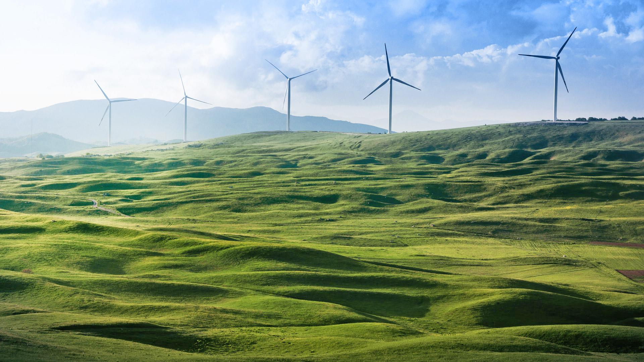

FROM REGRESSION MODELS TO DEEP LEARNING: A JOURNEY THROUGH WIND SPEED PREDICTION TECHNIQUES"
DEPARTMENT OF COMPUTER SCIENCE WRIGHT STATE UNIVERSITY
PROJECT PRESENTATION
Presented by
MADHURI BANDARI – U01093236
MANOJ KUMAR REDDY AVULA – U01067535
VENKATA SIREESHA MARELLA – U01097234
UDATHA KAVYA SRI – U01096839
Under the guidance of
Dr. Tanvi Banerjee

Slide 2

CONTENTS
ABSTRACT
OBJECTIVE OF THE PROJECT & DATASET OVERVIEW
EDA ( EXPLORATORY DATA ANALYSIS)
MODELS USED
CALCULATION AND CASE STUDY
LSTM (BEST MODEL)
RESULTS
CONCLUSION

Slide 3
ABSTRACT
In recent years, wind energy has emerged as a critical sustainable energy resource due to its eco-friendly, carbon-free, and non-polluting nature. Accurate wind speed forecasting plays a vital role in optimizing the use of wind energy for power generation.
In this project, multiple machine learning models — including Linear Regression, K-Nearest Neighbors (KNN), Random Forest, and Long Short-Term Memory (LSTM) networks were implemented to predict wind speed based on meteorological features.
Special attention was given to data preprocessing, where missing values were handled using different strategies: dropping missing entries, forward fill, and mean fill methods.
The models were evaluated using statistical error metrics such as Mean Squared Error (MSE), Root Mean Squared Error (RMSE) and Mean Absolute Error (MAE).
Among all the models, the LSTM network demonstrated the best performance, significantly outperforming traditional machine learning approaches. It captured the sequential patterns in the wind speed time series data effectively, providing highly accurate predictions.
The results validated that deep learning approaches, specifically LSTM models combined with careful data preprocessing, offer a promising solution for reliable short-term wind speed forecasting.

Slide 4
OBJECTIVE OF THE PROJECT & DATASET OVERVIEW
🎯 Objective: This project focuses on predicting wind speed using various machine learning models. The goal is to evaluate and compare their performances based on error metrics.
📌 Predict Wind Speed (WIND) using other meteorological features
Source: Collected from Kaggle
https://www.kaggle.com/code/majidmh/wind-speed-prediction-regression/input
Dataset Size: Contains 6574 entries (rows) & 9 columns
Target Variable: WIND (Wind Speed)
Data Type: Time-series tabular data with some missing values
🧾 Feature | 📋 Description
🗓️ DATE | Date of the observation (not used in modeling)
🌬️ WIND | Target – Wind speed (continuous)
🌧️ RAIN | Rainfall amount
🌡️ T.MAX | Maximum daily temperature
🌡️ T.MIN | Minimum daily temperature
🧊 T.MIN.G | Ground-level minimum temperature
☁️ IND | Weather indicator (e.g., humidity/cloud cover)
🌫️ IND.1 | Weather indicator (requires interpretation)
🌫️ IND.2 | Weather indicator (requires interpretation)
⚠️ Handling Missing Values
We used three strategies to handle missing data:
🧹 Drop Missing Values [6574-5638 = 936]
🔄 Forward Fill
➕ Mean Fill

Slide 5
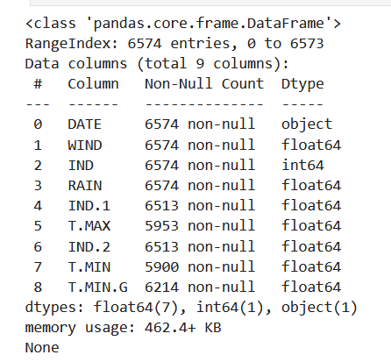
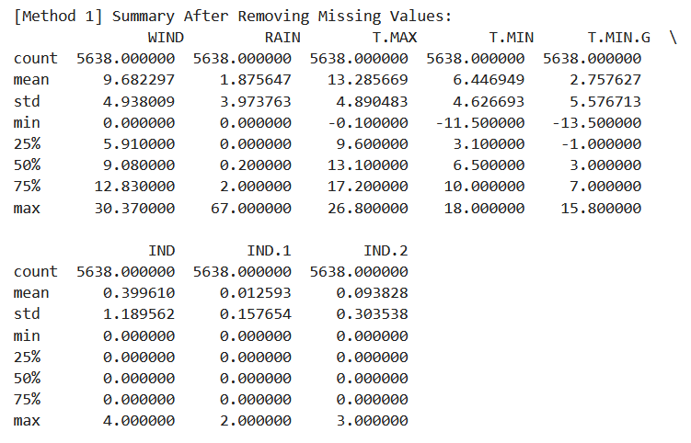
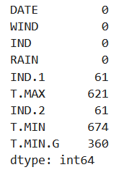
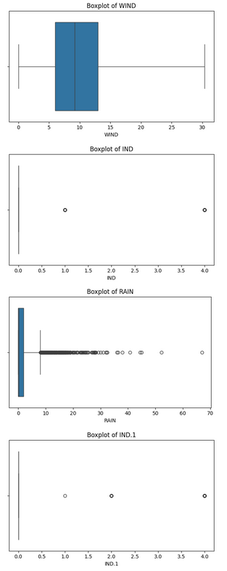
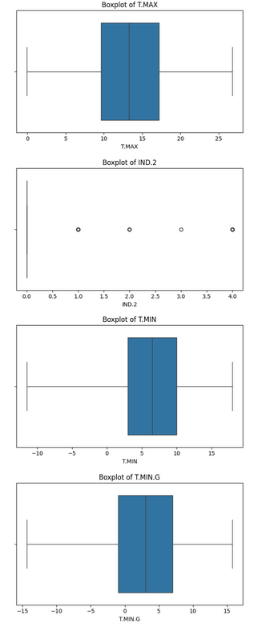
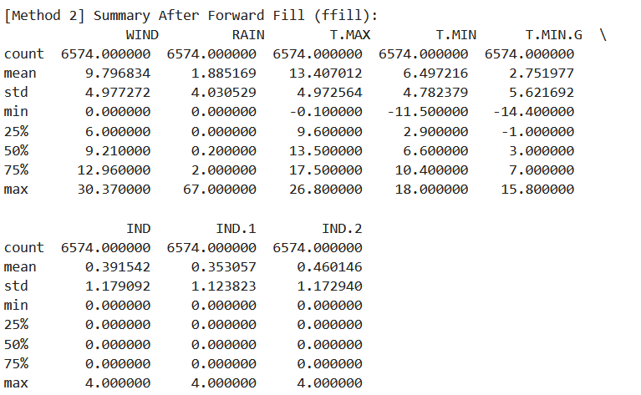
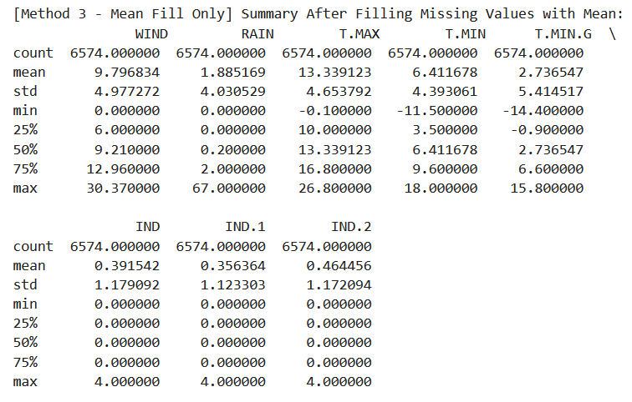
EDA (EXPLORATORY DATA ANALYSIS)
Outliers Check

Slide 6
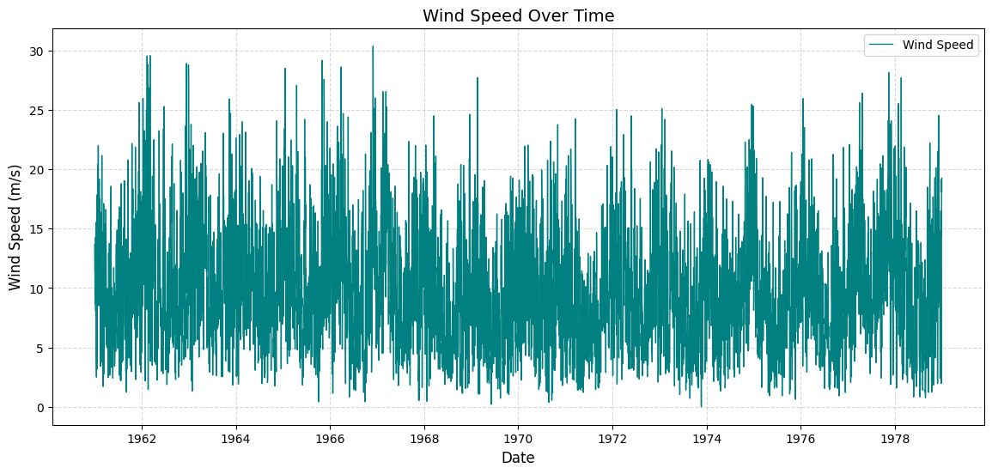
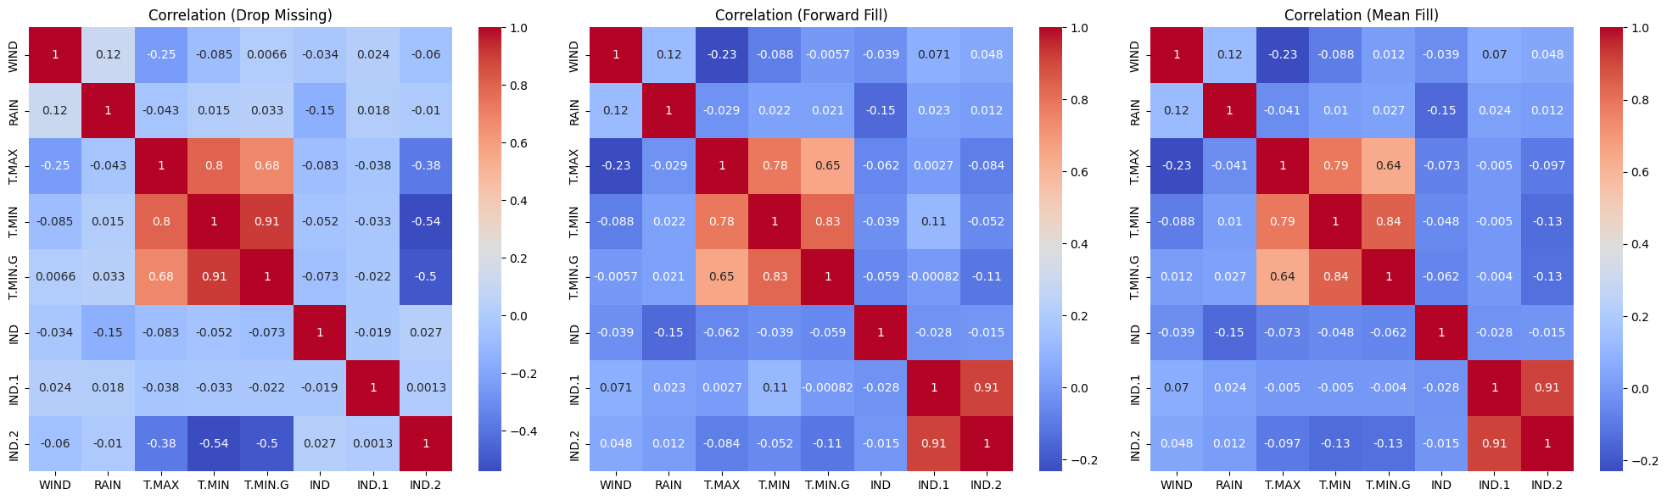
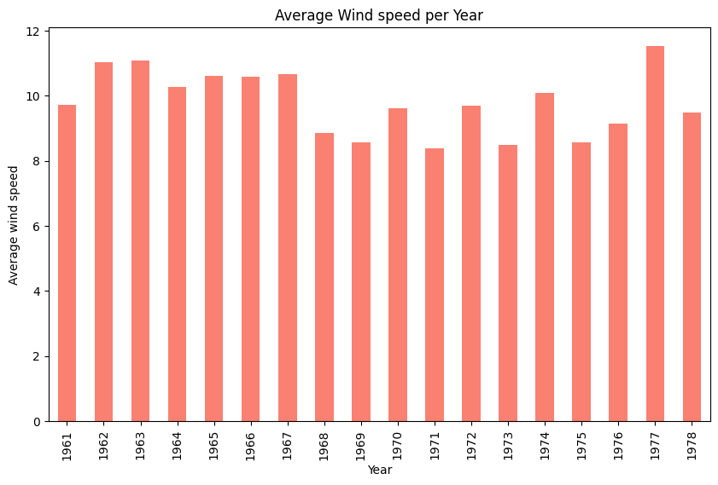
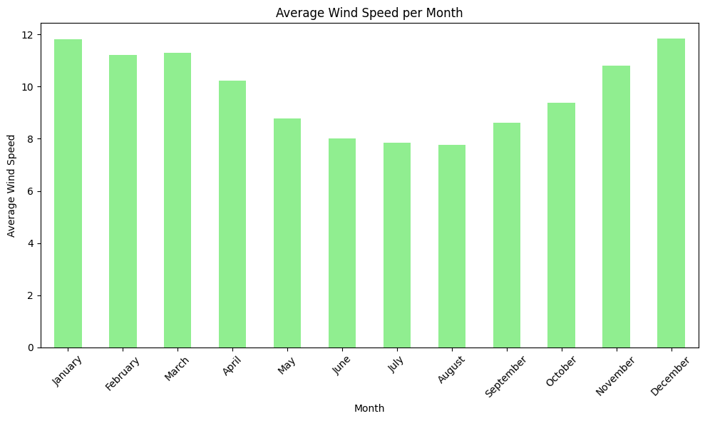
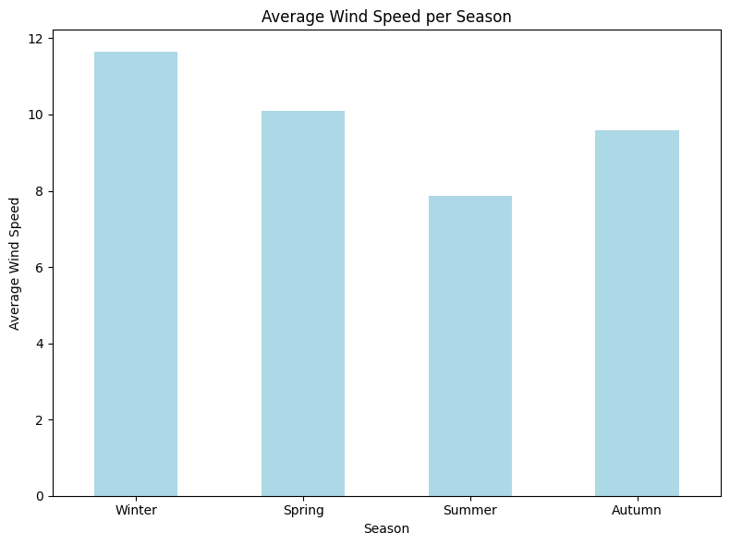
EDA (EXPLORATORY DATA ANALYSIS)
Handled missing values
Normalized input features
Feature selection
Train-test split for model evaluation
Overall, the correlation analysis shows that temperature features, especially T.MAX, have a mild positive relationship with WIND, justifying their use in model building, while different missing data handling methods slightly impact the strength of these relationships
Yearly Trend
Average wind speed remains relatively stable from 1961 to 1978.
From the yearly analysis, 1977 recorded the highest average wind speed among all the years studied
Monthly Trend
Higher wind speeds during winter months ( Dec, Jan, Feb).
Lower wind speeds during summer months (May, June, July).
Seasonal Trend
Winter has the highest average wind speed.
Summer has the lowest average wind speed.

Slide 7






MODELS USED
Linear Regression (1-Variable)
Feature Used: T.MAX (Maximum Temperature)
Goal: Understand how changes in maximum temperature alone influence wind speed. A basic regression model that uses only one feature (T.MAX).
Linear Regression (2-Variable)
Features Used: T.MAX (Maximum Temperature) and RAIN (Rainfall)
Goal: Analyze the combined linear influence of temperature and rainfall on wind speed. A multiple linear regression model with two independent variables.
Linear Regression (Multiple Variables)
Features Used: All input features (excluding WIND and DATE)
Goal: Capture the combined linear effect of multiple weather variables on wind speed. A multivariate linear regression model that considers several predictors simultaneously.
Random Forest Regressor
Features Used: All available features (excluding WIND and DATE).
Goal: Predict wind speed based on weather variables. Models the non-linear relationships between weather features and wind speed.
LSTM (Long Short-Term Memory) Network
Features Used: All input features (excluding WIND and DATE)
Goal: Forecast wind speed by learning temporal patterns in historical weather data. An advanced type of Recurrent Neural Network (RNN) designed to handle sequential data and long-term dependencies
K-Nearest Neighbors (KNN)
Features Used: All input features (excluding WIND and DATE)
Goal: Predict wind speed by averaging the wind speeds of the k most similar historical weather entries.
Note: All models will apply on three preprocessed datasets (Drop Missing, Forward Fill, Mean Fill) to compare their performance consistently.
Data Split: 80% training, 20% testing split, ensuring reliable evaluation of the model's performance.
Multiple models were implemented to predict wind speed, including Linear Regression (1-variable/2-variable/Multi-variables), Random Forest, KNN, and LSTM (Long Short-Term Memory).
These models were evaluated across three different versions of the dataset, preprocessed using Drop Missing, Forward Fill, and Mean Fill methods.
Each model was assessed using metrics such as MSE, RMSE, and MAE to compare their performance objectively.

Slide 8
LINEAR REGRESSION (1-VARIABLE/2-VARIABLES/MULTI-VARIABLES) OBSERVATIONS
Three Models Evaluated: 1-Variable (T.MAX), 2-Variable (T.MAX, RAIN) and Multi-Variable (T.MAX, RAIN, other features)
Three Data Handling Methods: Remove Missing Values, Forward Fill, Mean Fill.
Evaluation Metrics Used:
MSE (Mean Squared Error): Penalizes large errors.
RMSE (Root MSE): Interpretable in original units.
MAE (Mean Absolute Error): Measures average absolute error.
Best Model: ✅ Multi-Variable Regression with 'Remove Missing' method
MSE: 22.13, RMSE: 4.70 and mean fill - MAE: 3.79
Impact of Feature Addition: Errors decrease as more features are included → better predictions.
Imputation Comparison: Removing missing values gives consistently better results than forward/mean fill.
Remove Missing gives the best overall performance across all models.
Mean Fill performs better than Forward Fill in most models:
Slightly lower MSE, RMSE, and MAE values.
Mean Fill is especially useful when we can't afford to lose data by removing rows.
Model Type | Method Used | MSE | RMSE | MAE
1-Variable | Remove Missing | 22.8577 | 4.7810 | 3.8775
 | Forward Fill | 23.7905 | 4.8776 | 3.9192
 | Mean Fill | 23.7367 | 4.8720 | 3.9026
2-Variable | Remove Missing | 22.3561 | 4.7282 | 3.8331
 | Forward Fill | 23.3594 | 4.8332 | 3.8802
 | Mean Fill | 23.3231 | 4.8294 | 3.8653
Multi-Variables | Remove Missing | 22.1276 | 4.7040 | 3.8037
 | Forward Fill | 22.7181 | 4.7663 | 3.8310
 | Mean Fill | 22.4957 | 4.7430 | 3.7985

Slide 9
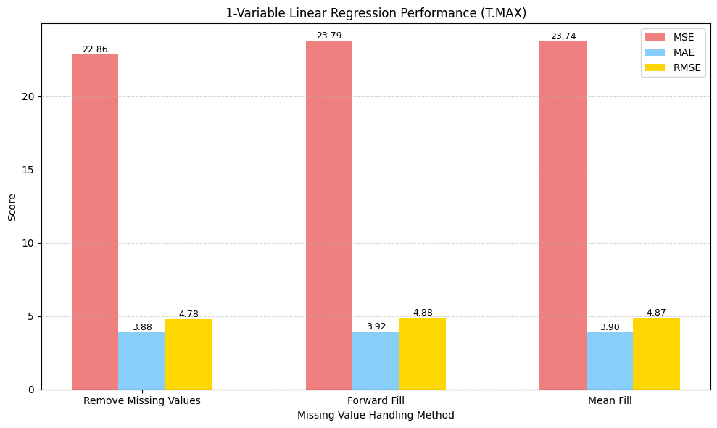
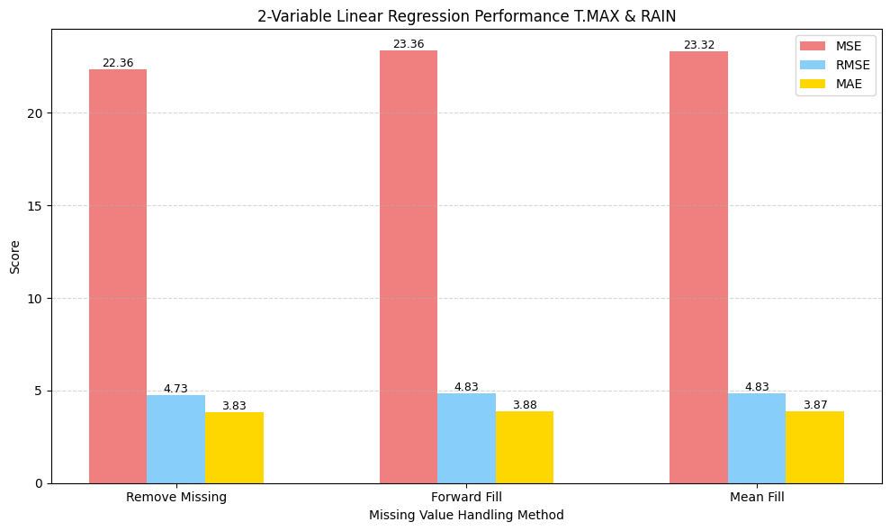
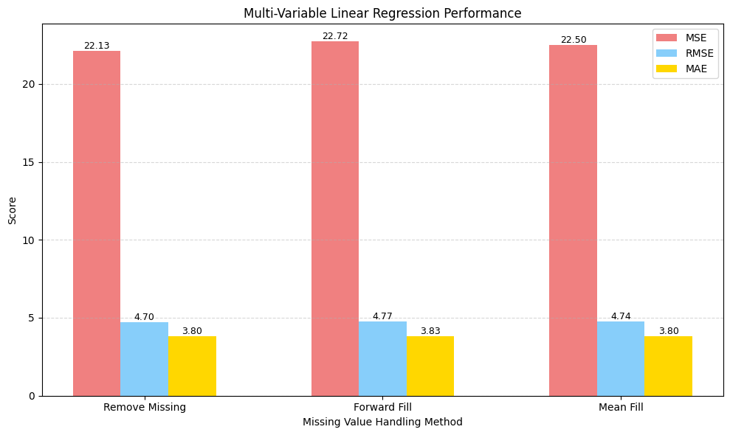
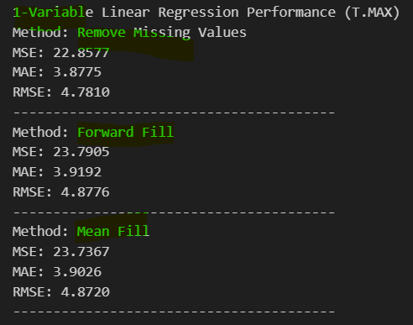
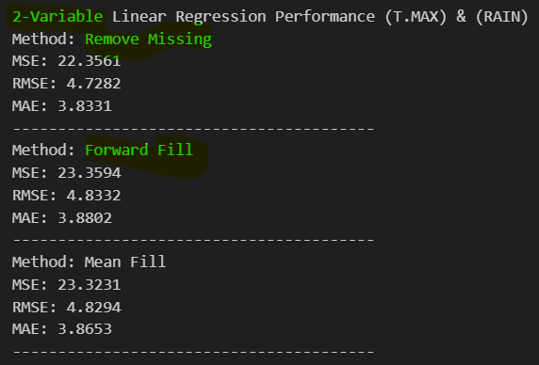
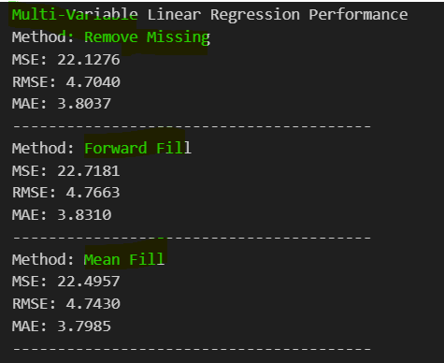
LINEAR REGRESSION (1-VARIABLE/2-VARIABLES/MULTI-VARIABLES) GRAPHICAL REPRESENTATION AND RESULTS
Conclusion: More features + proper data cleaning → better model accuracy.

Slide 10
KNN & RANDOM FOREST REGRESSION OBSERVATIONS
Model | Method | MSE | RMSE | MAE
KNN | Remove Missing | 22.0425 | 4.6949 | 3.6591
 | Forward Fill | 21.9884 | 4.6892 | 3.6849
 | Mean Fill | 22.5459 | 4.7482 | 3.7094
Random Forest | Remove Missing | 19.5884 | 4.4259 | 3.4315
 | Forward Fill | 21.0440 | 4.5874 | 3.6299
 | Mean Fill | 21.4673 | 4.6333 | 3.6484
Random Forest outperforms KNN in all evaluation metrics.
Remove Missing method consistently delivers the lowest error for both models.
Random Forest: Best MSE: 19.5884, Best RMSE: 4.4259, Best MAE: 3.4315
KNN's performance is less stable, slightly worse across all imputation methods.
Forward Fill > Mean Fill for both models across all metrics.
KNN has higher error and more sensitivity to missing data handling.
Random Forest with Remove Missing is the best performing setup in this study.

Slide 11
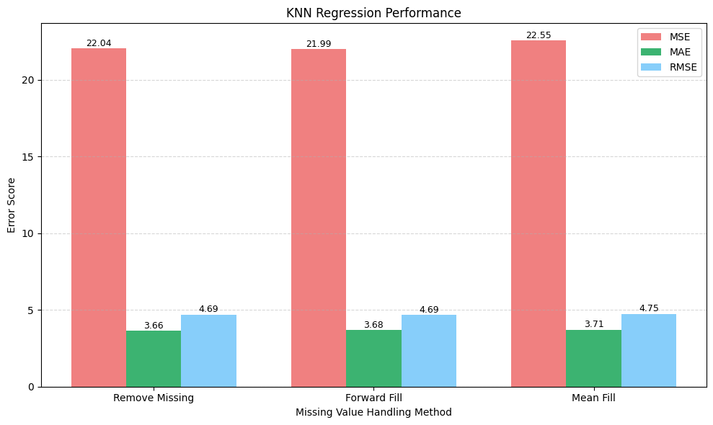
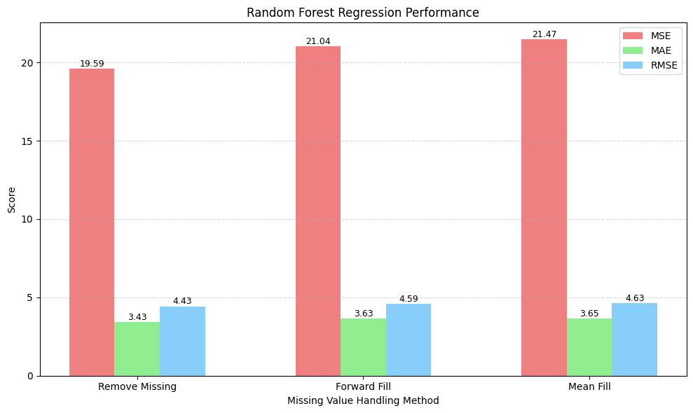
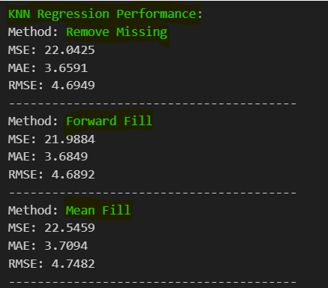
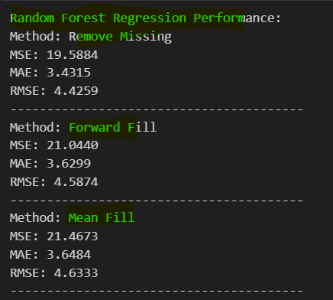
KNN & RANDOM FOREST REGRESSION GRAPHICAL REPRESENTATION AND RESULTS
"Random Forest outperforms KNN overall; more features combined with proper data cleaning significantly improve model accuracy."

Slide 12
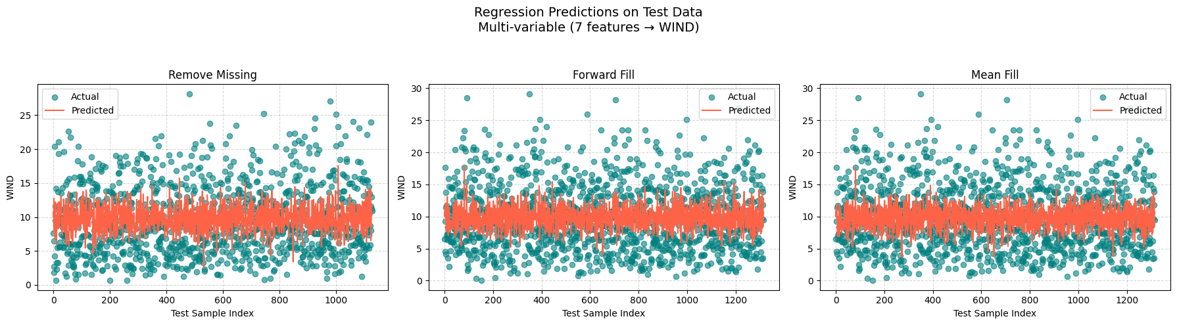
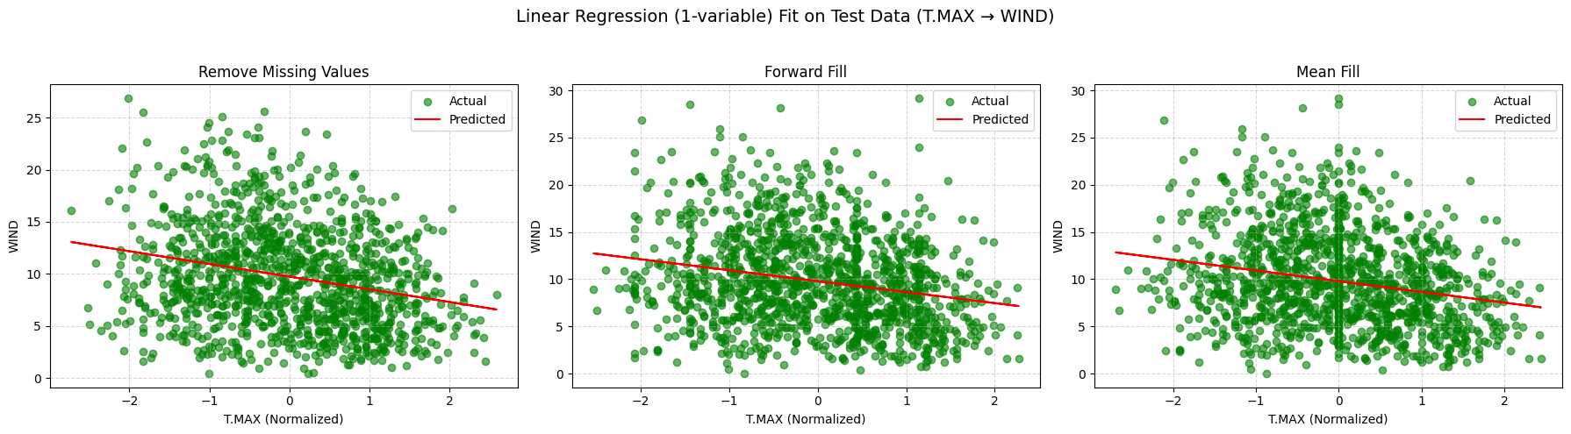
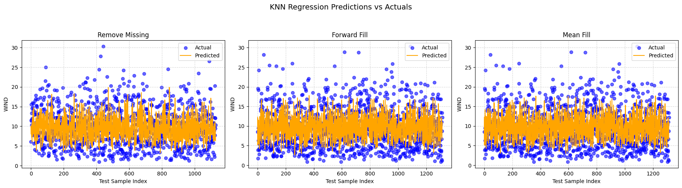
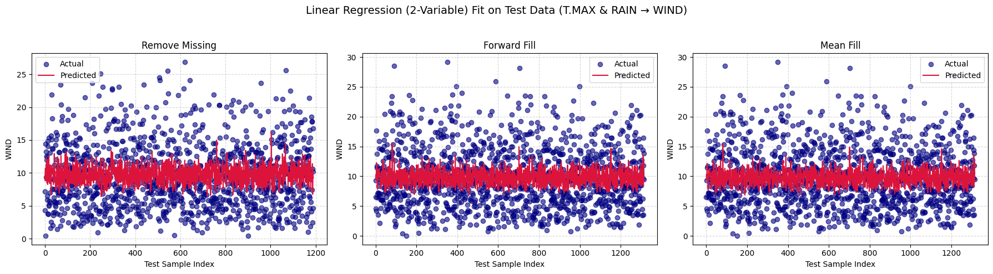
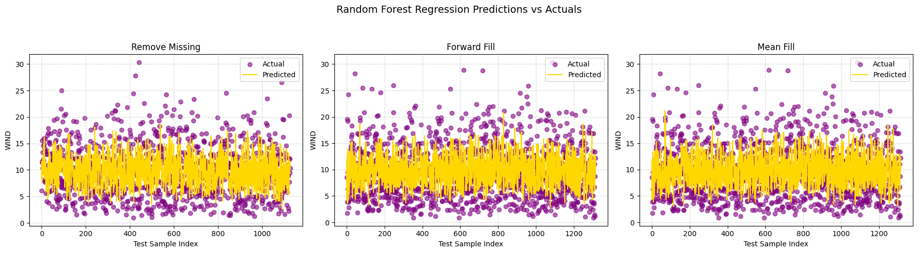
ACTUAL VS PREDICTED (TEST DATA PREDICTIONS) MODEL-TO-MODEL COMPARISON

Slide 13
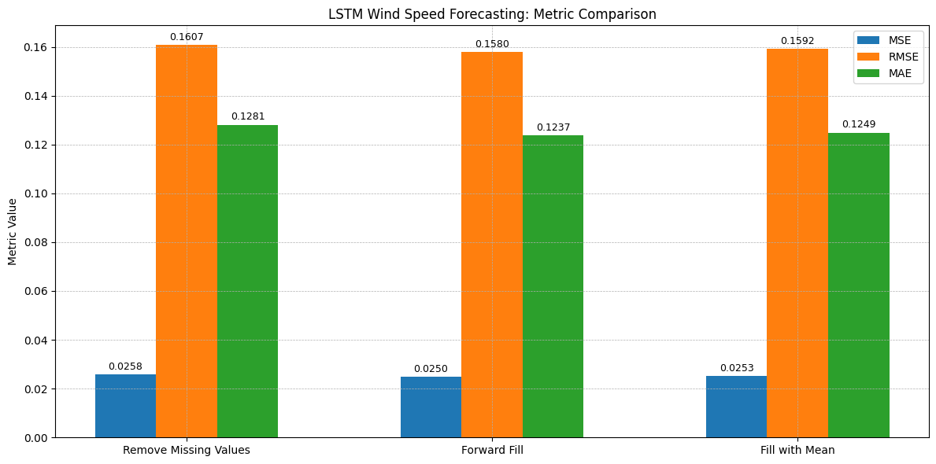
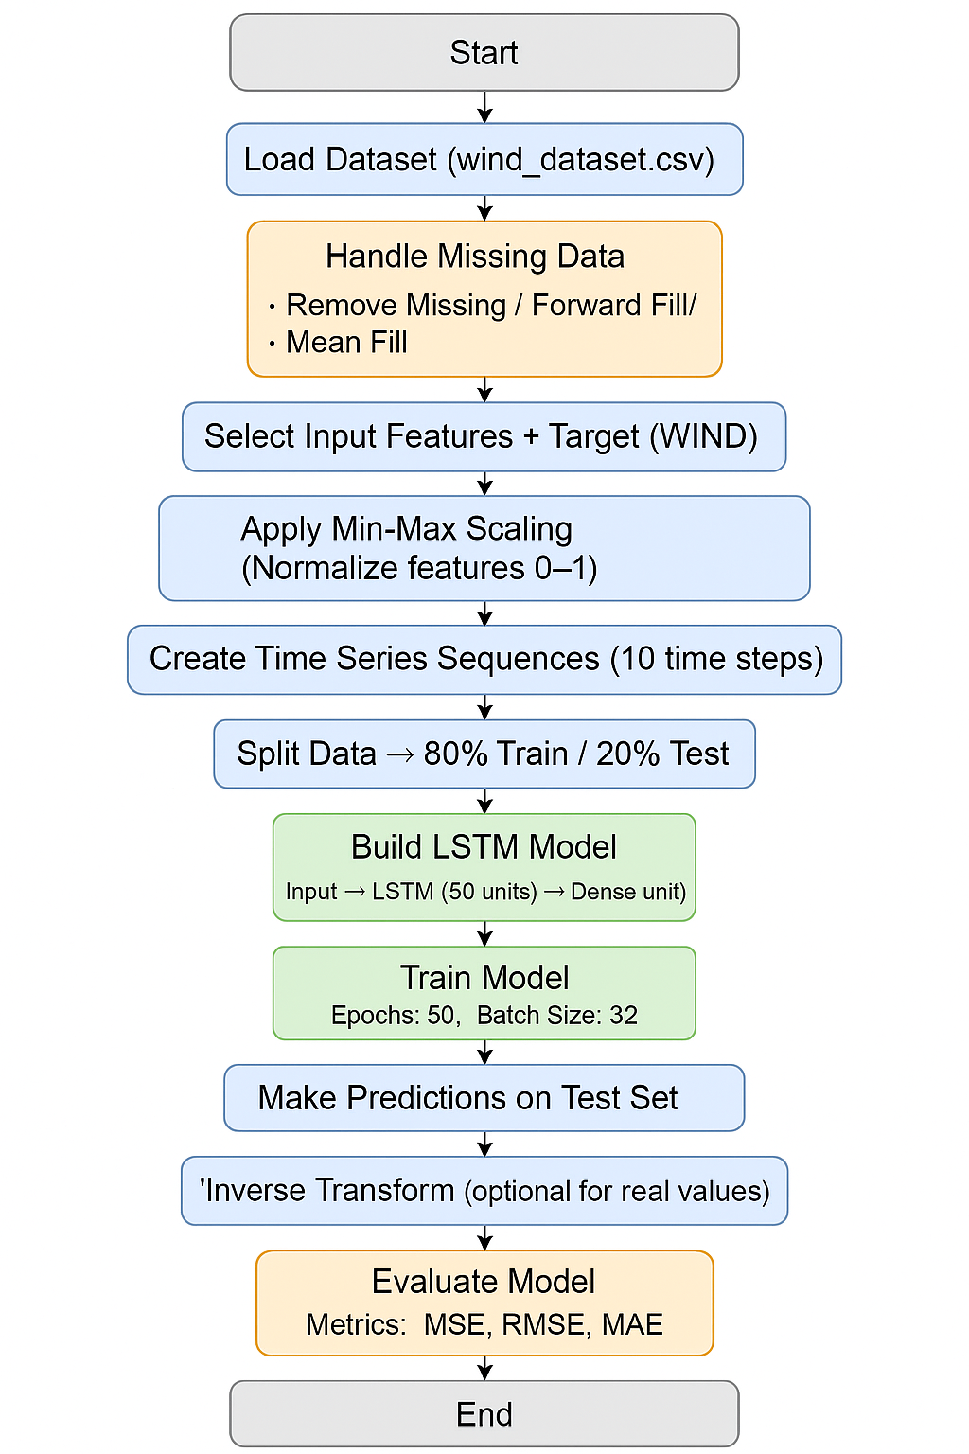
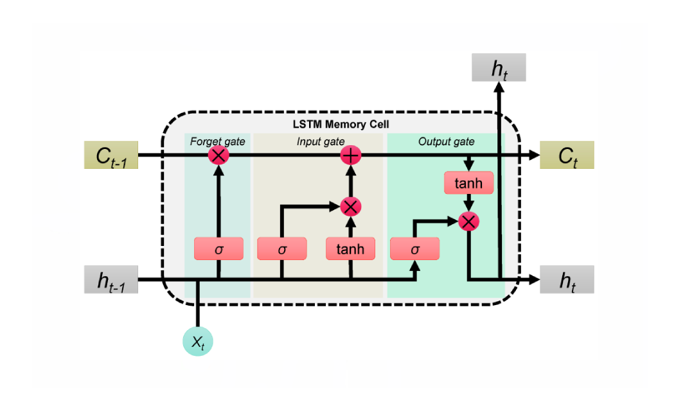
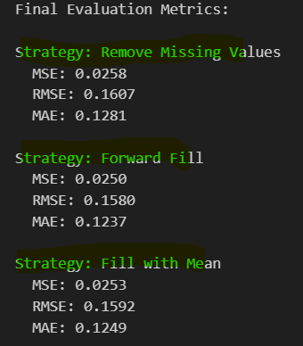
LSTM(BEST MODEL)
LSTM (Long Short-Term Memory) is a type of Recurrent Neural Network (RNN), specifically designed to model sequential data or time-series data.
LSTMs have memory cells that store information over time. These cells help the model retain important data and "forget" irrelevant information, allowing it to learn patterns that span across long sequences.
LSTM outperforms traditional models like Linear Regression, KNN and Random Forest Regression in terms metrics across all data imputation strategies.
Improved Prediction Accuracy: The LSTM model significantly reduces the error compared to linear models and KNN.
LSTM Performance: The predicted values closely track the actual values.

Slide 14
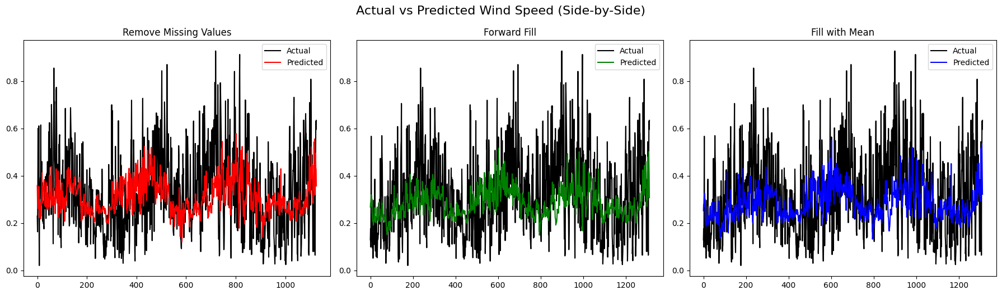
LSTM MODEL EVALUATION: ACTUAL VS PREDICTED

Slide 15
STATISTICAL ERROR VALUES OF ALL APPROACHES
Model | MSE (Remove) | MSE (Forward Fill) | MSE (Mean Fill) | MAE (Remove) | MAE (Forward Fill) | MAE (Mean Fill) | RMSE (Remove) | RMSE (Forward Fill) | RMSE (Mean Fill)
Linear (1 Var) | 22.8577 | 23.7905 | 23.7367 | 3.8775 | 3.9192 | 3.9026 | 4.7810 | 4.8776 | 4.8720
Linear (2 Var) | 22.3561 | 23.3594 | 23.3231 | 3.8331 | 3.8802 | 3.8653 | 4.7282 | 4.8332 | 4.8294
Linear (Multi Var) | 22.1276 | 22.7181 | 22.4957 | 3.8037 | 3.8310 | 3.7985 | 4.7040 | 4.7663 | 4.7430
KNN | 22.0425 | 21.9884 | 22.5459 | 3.6591 | 3.6849 | 3.7094 | 4.6949 | 4.6892 | 4.7482
Random Forest | 19.5884 | 21.0440 | 21.4673 | 3.4315 | 3.6299 | 3.6484 | 4.4259 | 4.5874 | 4.6333
LSTM | 0.0258 | 0.0250 | 0.0253 | 0.1281 | 0.1237 | 0.1249 | 0.1607 | 0.1580 | 0.1592

Slide 16
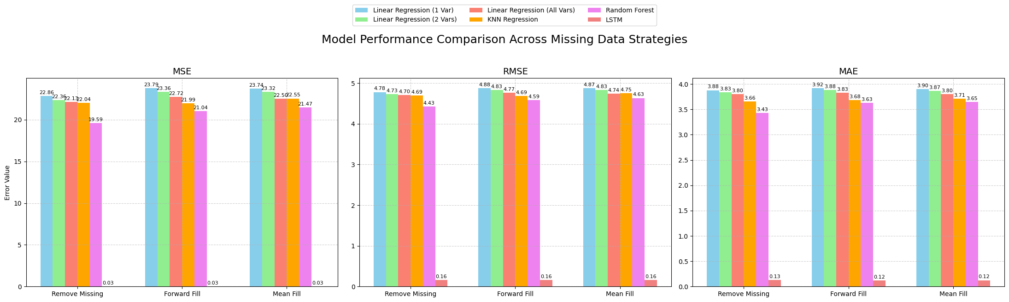
GRAPHICAL REPRESENTATION OF ALL MODELS ON DIFFERENT DATASETS

Slide 17
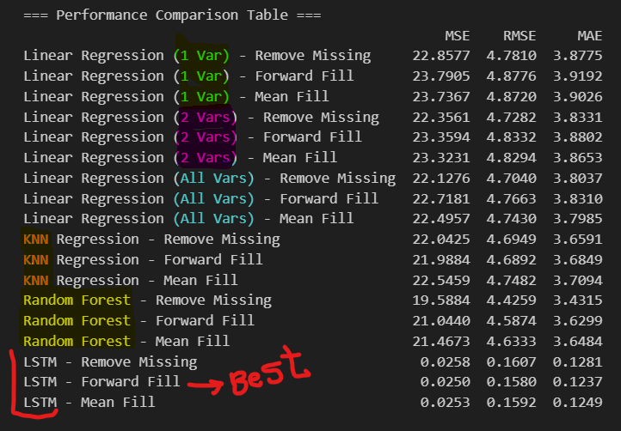
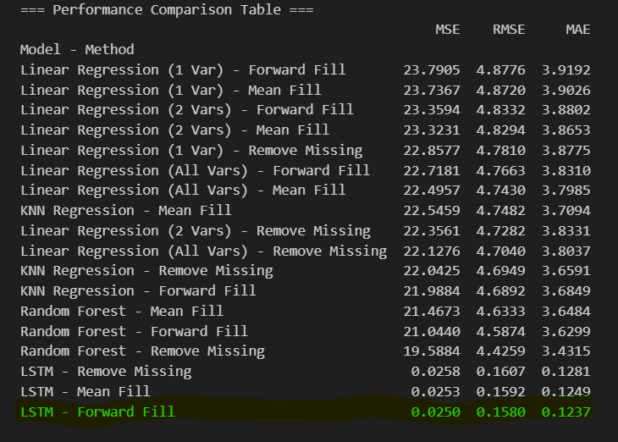
BEST MODEL (LSTM)
Best Model: LSTM (Long Short-Term Memory)
The LSTM model outperformed all other models across all dataset versions.
LSTM achieved the lowest values of MSE, RMSE, and MAE compared to all other models.
Its performance was consistently better across all three preprocessed datasets (Drop Missing, Forward Fill, Mean Fill).
Especially when using Forward Fill, LSTM handled sequences smoothly without abrupt gaps.

Slide 18
RESULTS AND CONCLUSION
Multiple models were tested for wind speed prediction
LSTM (Long Short-Term Memory) emerged as the best model across all dataset versions.
Achieved the lowest error metrics (MSE, RMSE, MAE) consistently across:
Drop Missing, Forward Fill, Mean Fill
Forward Fill preprocessing + LSTM delivered the best overall performance, ensuring smooth sequence continuity.
LSTM is the most reliable and precise model for wind speed forecasting in this project.
Recommendation: Use LSTM combined with Forward Fill for future wind speed prediction tasks.

Slide 19
FUTURE WORK
Apply EEMD-LSTM: Combine signal decomposition with LSTM for better forecasting.
Include wind direction and more environmental signals for better accuracy.
Apply hybrid models (e.g., EEMD + LSTM, CNN + LSTM).
Deploy as a web-based wind forecasting tool for energy.

Slide 20
THANK YOU

